Slide 1
Assignment 3 Longitudinal Data Analysis
Kendall Brown - r0773111
Raïsa Carmen - s0204278
Stefan Velev - r0924289
Adhithya Unni Narayanan - r0776057

Slide 2
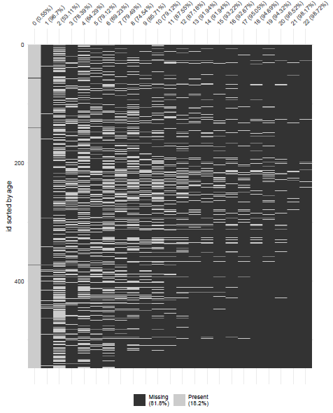
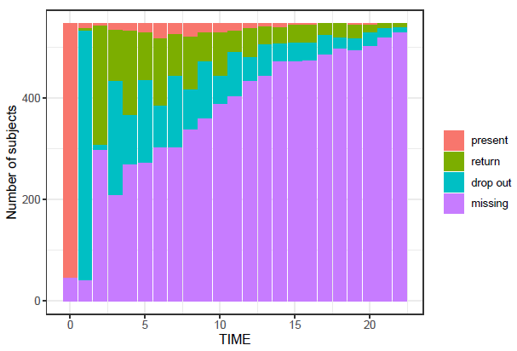
Missingness exploration
Missingness as per the graph is not monotone. The subjects maybe missing at one time instance but it comes back later.
Subjects are rarely measured two years in a row, most are not measured 𝑡 = 1, and the number of subjects that stay missing gradually increases as time passes.

Slide 3
Mixed model explaining the missingness:
As time increases, subjects are more likely to be missing.
Assume Missing At Random (MAR)
Variable | Intercept | TIME | sideright | age | R(t-1)
Estimates | 2.22*** | 0.24*** | -0.19*** | 0.10 | -2.67***

Slide 4
Direct Likelihood Analysis
In a direct likelihood analysis, missing values are assumed to be ignorable.
Linear mixed effects model is drafted using R for the direct calculation for each patient’s respective likelihood functions.
R package nlme is used.
Models with different covariance structures (simple and compound symmetry) are compared and parameter estimates from both covariance structure remains stable.
Multiple Imputation Analysis
Artificial data points are generated according to the algorithms: Predictive mean matching, Bayesian linear regression, Unconditional mean imputation, and imputation by random forests.
2 covariance matrix structures: simple and compound symmetry.
Respective to the different covariance structures, parameter estimates are largely the same between model pairs of opposing covariance patterns.
For comparing these models, an analysis of the empirically observed within-group standardized residuals is considered.
direct likelihood (DL) method results in the smallest interval of empirically observed within-group standardized residuals, with unconditional mean imputation (Mean) potentially resulting in largest degree of error.

Slide 5
Weighted GEE
Weights are specified using the inverse dropout probability methodology and then is proceeded with model selection of the Weighted GEE. QIC and a greedy methodology are used for this purpose.
The correlation structure of the model is explored using the QICu. The best performing is an independent correlation structure.
MI GEE
The imputation methods used are same as the multiple imputation analysis.
3 Multiple imputation models are evaluated. Model based on all imputed data sets, both monotone and FCS, a model based only on the FCS imputation, and a model based only on the monotone imputation.
It is observed that weighted GEE outperforms all 3 of the MI GEE models. The reason for this is the large number of values which we needed to impute.
Within the MI GEE the one based on monotone imputation performs the best.
The MI Method with unconditional mean imputation considering both monotone and FCS outperforms the weighted GEE.
Best performing model is the unconditional mean monotone imputation.

Slide 6
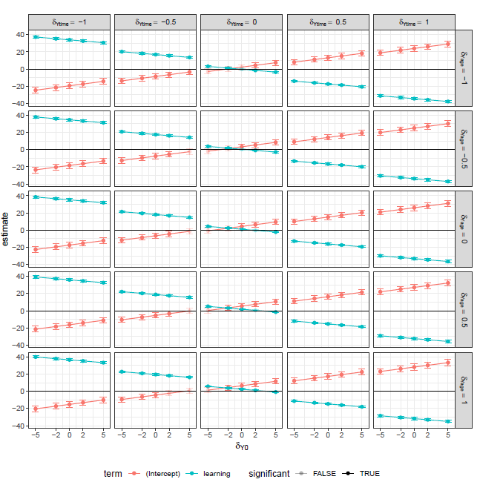
Sensitivity Analysis
Imputation under a MNAR mechanism by the not at random fully conditional specification (NARFCS) is used to check the model results under MAR assumption is robust if that assumption is not realistic.
This method works, even if the missingness is not monotone, and allows us to test the effect of different shifts in the MNAR imputed values on the model coefficients.
These shifts may depend on the covariates thus, different shift scenarios have been created with respect to each covariate and the data is imputed ten times for each scenario and a GEE model is fitted with a simple correlation structure on the imputed data.

